Slide 1
ASL Translator
by Jinhyung Ahn, Qintao Ying, Jiawen Chen

Slide 2

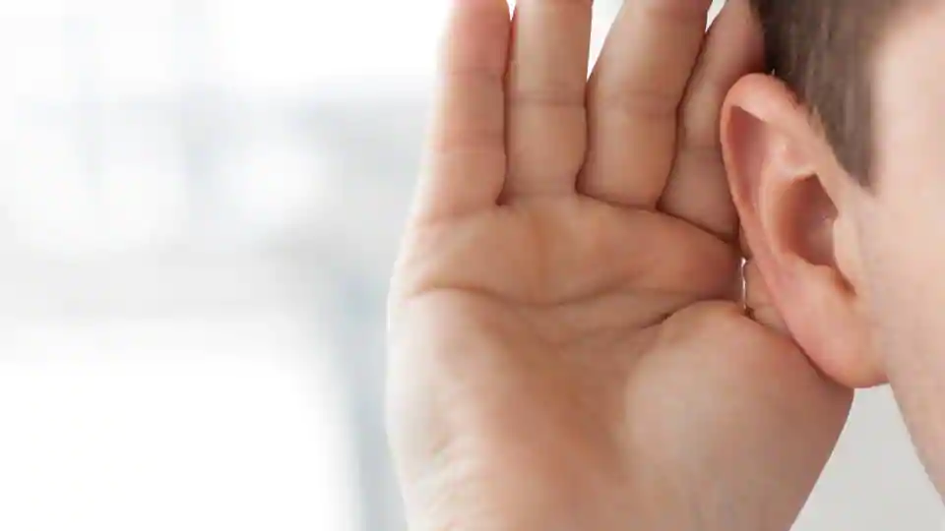
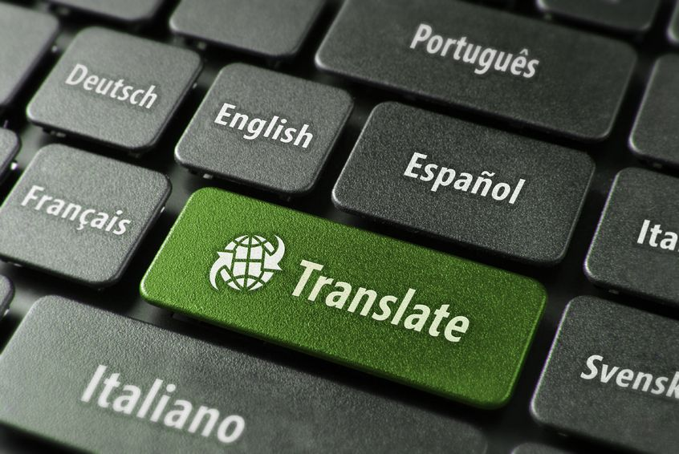
Introduction
Image source: daytranslations.com, hindustantime.com,

Slide 3
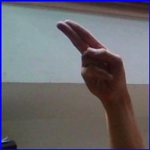

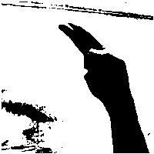
Pre-Processing
Background removing
Introduce the data
Change the image into binary (0,1) matrix
Subtract the matrix of the background
Convert the matrix into image
H699.jpg nothing72.jpg

Slide 4
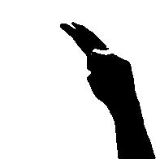
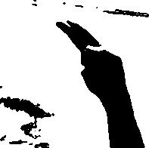
Pre-Processing
2. Denoising
Area counting er
Erase
the
rest

Slide 5
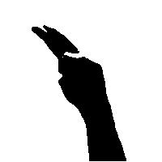
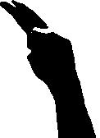
Pre-Processing
3. Cutting and saving an image into the original size

Slide 6
Outcome
Test Accuracy
- Based on the models we built to make predictions
Dataset | KNN | Random Forest
Augmented dataset | / | 99.0%
Preprocessed dataset | 97.6% | 99.0%
- Efficiency and accuracy are both hold for pre-processed dataset
Notes:
We used two datasets here in order to emphasize how efficient the preprocessed data is.
The augmented dataset has 87000 images. But the preprocessed dataset only has about 5000 images, and their accuracies are approximately similar.

Slide 7
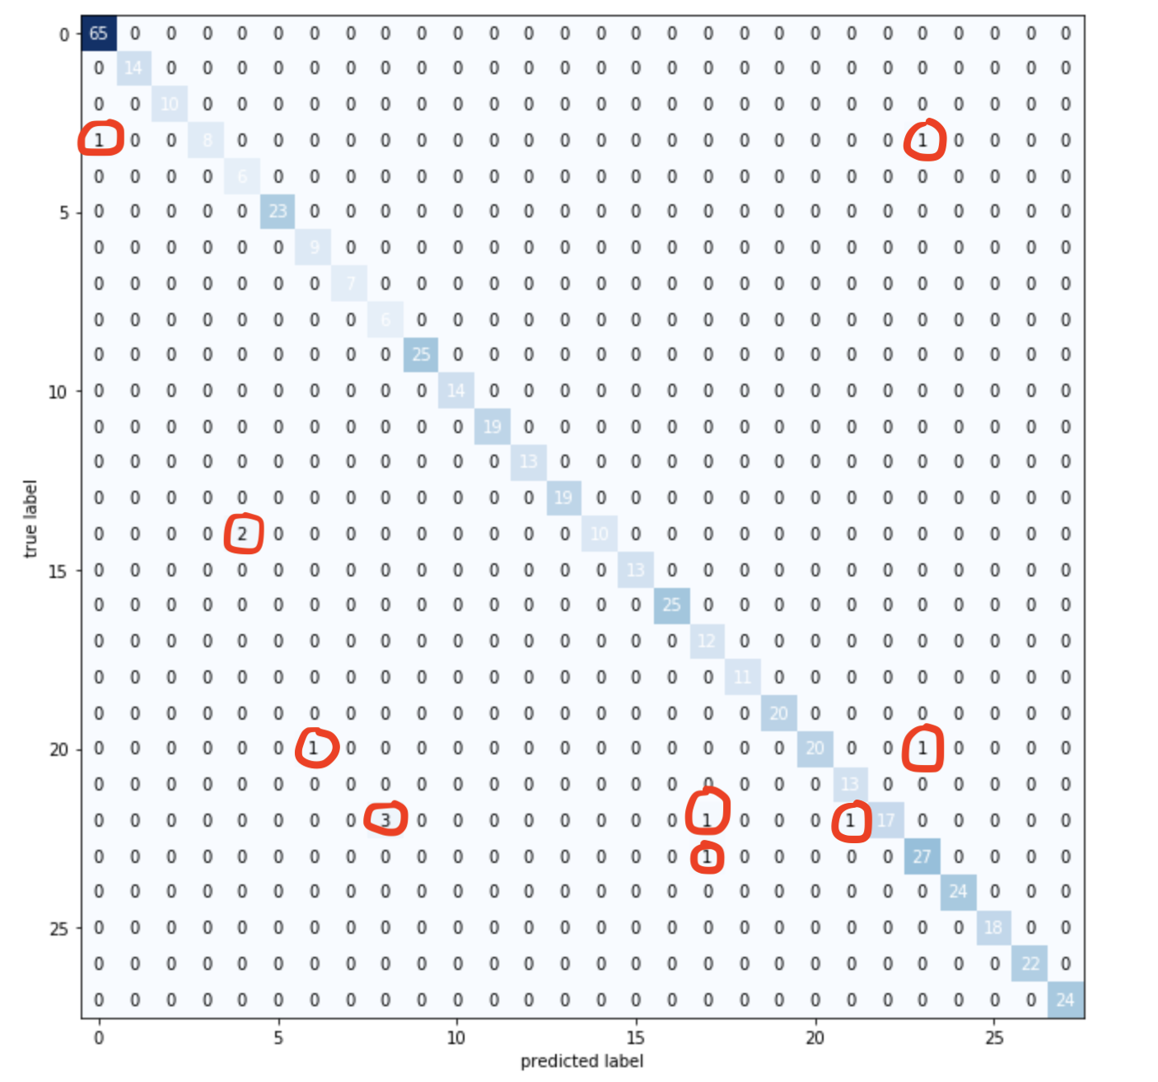
Multiclass Confusion Matrix
Result of KNN using preprocessed dataset
Two ‘D’ are categorized as ‘A’ and ‘X’
Two ‘O’ are categorized as ‘E’
Two ‘U’ are categorized as ‘G’ and ‘X’
five ‘W’ are categorized as ‘I’, ‘R’ and ‘V’
One ‘U’ is categorized as ‘R’

Slide 8
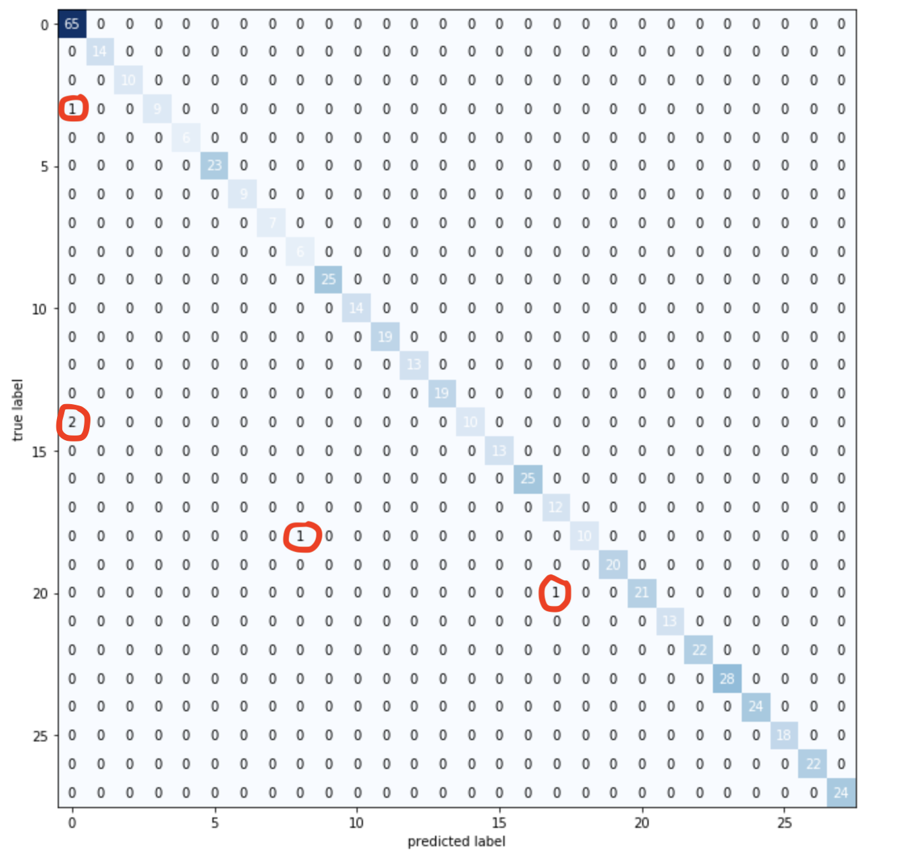
Multiclass Confusion Matrix
Result of Random Forest using preprocessed dataset
One ‘D’ is categorized as ‘A’
Two ‘O’ are categorized as ‘A’
One ‘S’ is categorized as ‘I’
One ‘U’ is categorized as ‘R’

Slide 9

Feature Importance selection
Divide every pre-processed picture into four equal parts
Build the random forest model based on each of them

Slide 10
Feature Importance selection
Analysis
Right part is more important than left part
Bottom part is more important than upper part
3.And the most frequently appeared finger in the bottom right part is thumb
 | Upper left | Upper right | Bottom left | Bottom right
Accuracy(%) | 78.2 | 84.1 | 86.5 | 89.2

Slide 11
Q&A

Slide 12
Thank you!

